Slide 1

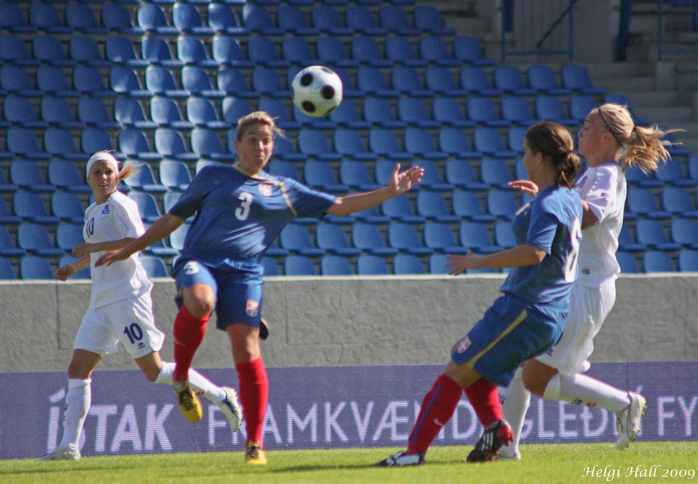
FIFA WOMEN’S
WORLD CUP
ANALYSIS
Here’s how the women in Football have
been crushing it!

Slide 2

INTRODUCTION
This report outlines the Exploratory Data Analysis (EDA) performed on the Fifa Women’s World cup dataset. The primary goal of this EDA was to gain a better understanding of the dataset's structure, identify potential data quality issues and anomalies, fix it up if there’s any and generate meaningful insights that can enhance data_ driven decision making.
1.1 Goals for the EDA
The main goals of this EDA are as follows:
To understand the variables in the dataset and their relationships that they have with each other.
To clean up the data,format and convert it to the best form possible for Analysis
To explore the distribution of variables and identify any trends or patterns.
To generate insights and recommendations based on the analysis of the data.
1.2 Summary of Steps
The following steps were taken to perform the EDA:
Data acquisition: The dataset was obtained from Kaggle,an online platform for Obtaining data.
Data exploration: An initial exploration of the dataset was conducted to gain a better understanding of its structure this included understanding what each column represents and checking the shape of the data. That is,the number of rows and columns present
Data cleaning and transformation: The dataset was cleaned and transformed to ensure good data quality,Structure and format.
Analysis and visualization: The dataset was analyzed and visualized to generate insights and identify trends.
Recommendations and parting words: Recommendations were made based on the analysis, and conclusions were drawn.

Slide 3

DATA EXPLORATION
The FIFA Women’s world cup dataset contains information about how the game has played out between the period of 1991-2019. The dataset contains 136 rows and 19 columns. The variables include information about the different squads that took part in the games,the year that they took part in the game,the number of players per squad for each year,the mean age of players in a squad,their possession rate,matches played,their starts,playing time in minutes,playing time in minutes divided by 90,number of goals,number of assists,non-penalty goals,penalty goals made,penalty goals attempted,the number of yellow cards collected per squad,the number of red cards collected per squad,assists per 90 and the number of goals plus assists per 90.

Slide 4
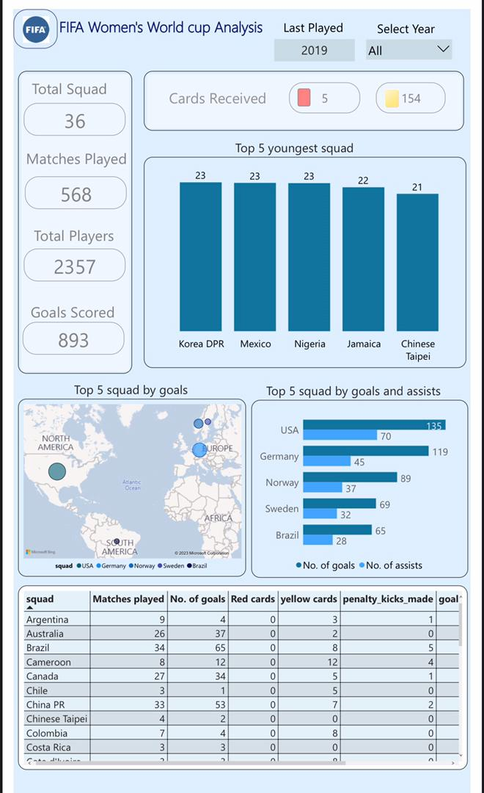
DATA CLEANING
DASHBOARD
3.1 Initial Set-up
The initial setup involved checking for duplicate values and null values. The data had no duplicate value but null values were spotted in a few columns( 40 null values in the possession column,74 null values in the red cards and yellow cards columns respectively). The null values in the yellow and red cards columns were replaced with zero while the null values in the possession column were replaced with the mean of the total possession.
3.2 Analysis and Visualisations
Several visualisations were generated to showcase trends and patterns in the dataset. The card chart was used to represent the count of squad,total number of matches played,total players and the total number of goals scored. The column chart was used to represent the top 5 youngest squad,the map was used to represent the top 5 squad by goals,the clustered bar chart was used to showcase the top 5 squad by goals and assists.

Slide 5

INSIGHTS
RECOMMENDATIONS
After Several analysis,the following insights were made :
The top 5 Squads based on the Number of goals scored are The USA, Germany, Norway, Sweden and Brazil.
The least 5 countries by goals are Equatorial Guinea,Chile,Jamaica,South Africa and Ecuador. By Continent, Europe tops the chart by having the highest number of goals while Africa has the least number of goals.
A high possession percentage does not guarantee that a squad would score a high number of goals
Leading squads have older players on their team. The teams with younger players do not exactly have high number of goals.
The size of a squad does not determine their productivity.
A squad starting a game could be a factor for winning a match
The USA, Germany, England, Brazil and Cameroon are the top 5 squads capable of converting penalties to goals.
The Least Scoring squads,majorly from the African continent, should employ various strategies in nurturing young talents to make them become really skillful at scoring goals.
Effective defense strategies should be employed by these squads to prevent opponent from scoring to many goals.
Team selection should be a crucial process for these teams. Older players,mostly between the age of 26 should be highly considered for the game.

